Slide 1

COVID-19 DATA ANALYSIS
Belgium
Group green
Chisako Tani
Hema Vivekanandan
Kavita Kathaith
Siddhant Navaratna
Sushma Srinivas

Slide 2
Background
Belgium is among the top 20 countries affected by COVID-19
First case was reported on Feb-4th 2020
Number of cases : Over 50,000
Number of deaths : Over 8,000
Belgium has a population of 11.5 million
66 people in every 100,000 have died from Covid-19

Slide 3
Datasource
Data was collected from Sciensano which is a research and national public health institute of Belgium
Time period of the dataset is 1st March 2020 to 29th April 2020
The weather data was collected from https://weather.com
Data cleaning
Missing values deleted
Irrelevant columns were deleted
Added temperature data for each entry corresponding to their respective dates and regions
Duplicate records from combined dataset removed

Slide 4
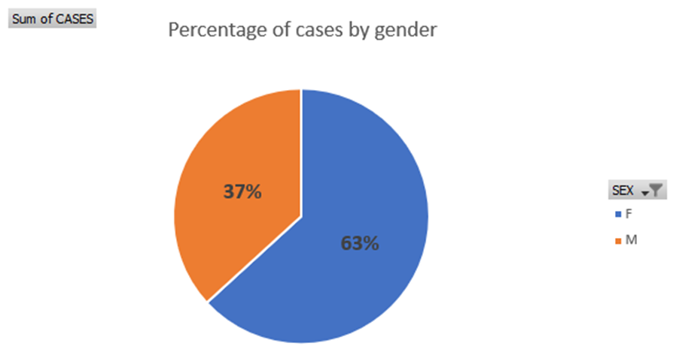
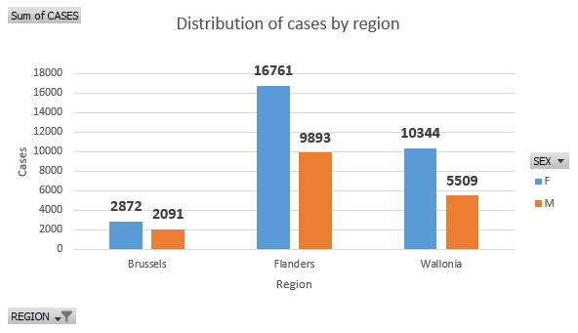
Number of cases by gender

Slide 5
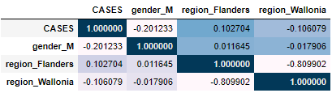
Statistical analysis
The gender bias in number of cases maybe due to several factors
Underlying medical condition
Overall male and female population of the country
Population of male and female healthcare workers
Population of men and women being tested

Slide 6
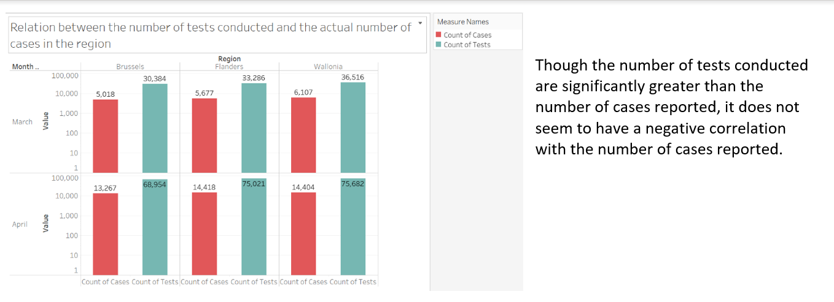
Analysis by Region

Slide 7
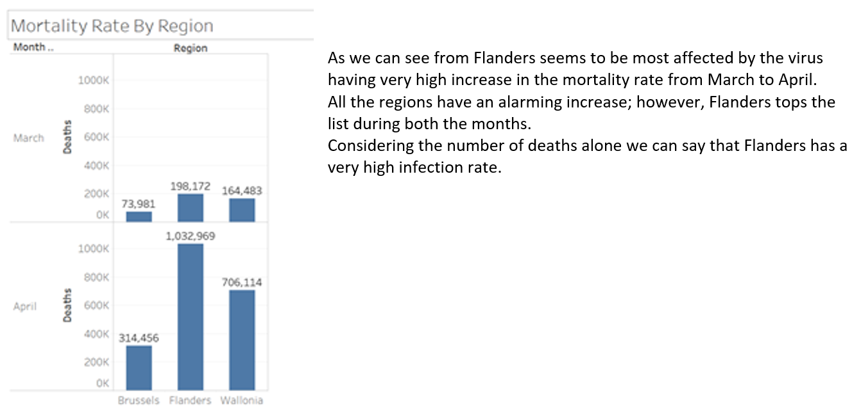

Slide 8
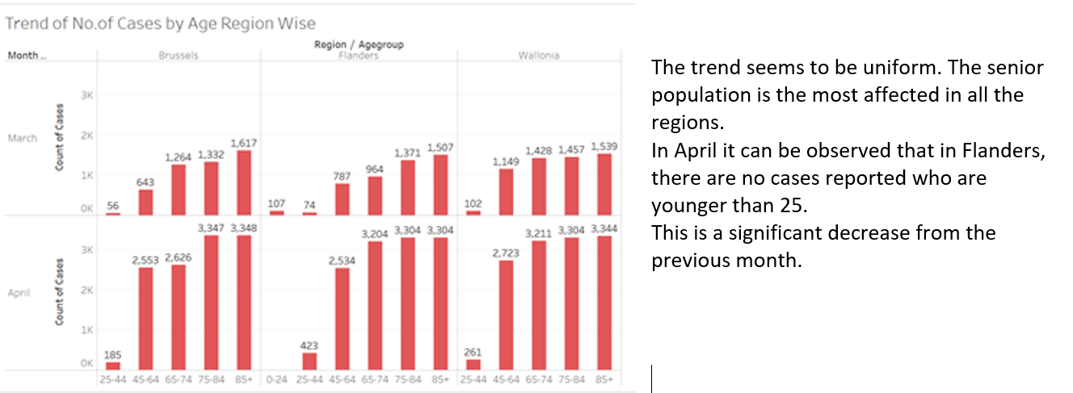

Slide 9
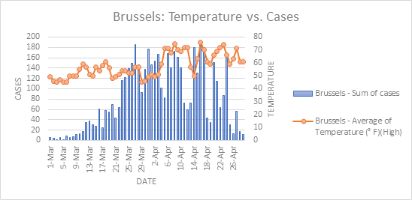
Temperature Effect in the Infection rate
Hypothesis:
The potency of the coronavirus decreases in higher temperatures.

Slide 10
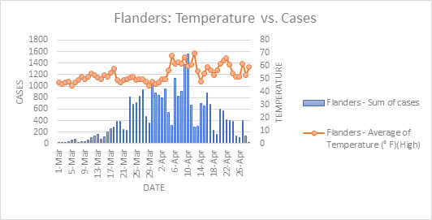
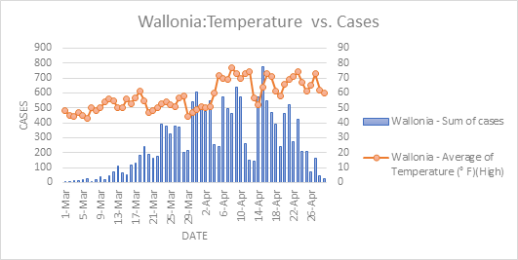
From the graphs we can see that even as the there is a fluctuation in the temperatures, there is no certain correlation between the temperature change and the number of cases reported.

Slide 11
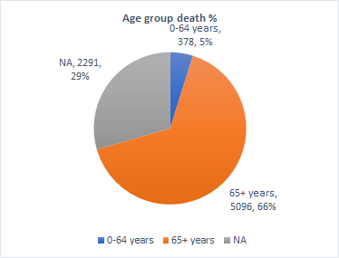
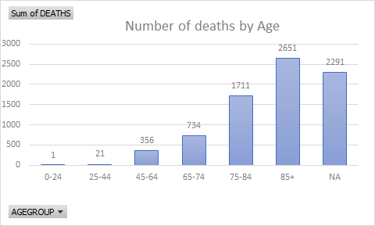
Mortality rates in different age groups

Slide 12
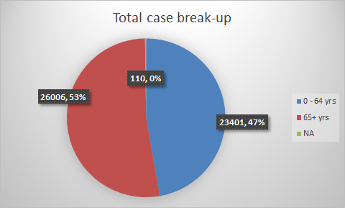
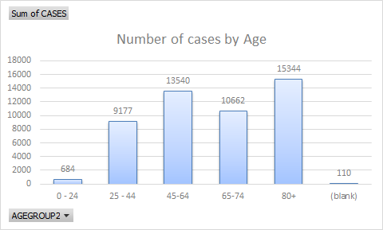
Age does play a significant part in mortality rates
Number of cases is almost similar for below and above 65 years group
Mortality rate is significantly higher for 65+ age group
Mortality rate in 0-64 year group is 1.6%
Mortality rate for 64+ year group is 19.6%

Slide 13
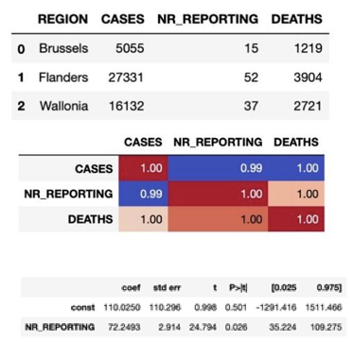
The number of hospitals in each region
•The number of hospitals, cases, deaths in Brussels, Flanders, Wallonia seem to have strong correlations
•The results of regression analysis show one hospital contributes 72 deaths.

Slide 14


Further regression analysis in the EU
Number of beds
Number of doctors
Number of nurses
Amount of health spending
Number of Deaths per 1000 population
Number of Recovered per 1000 population

Slide 15
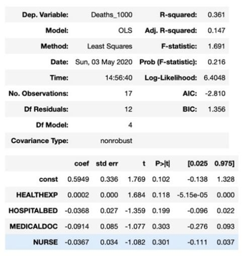
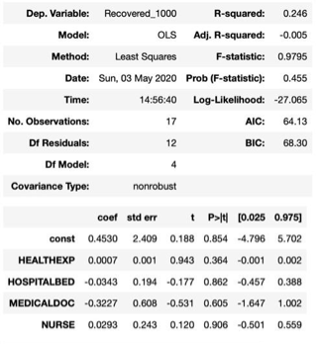
Two regression models for deaths and recovered
P-values are greater than 0.05.
Dependent variables are not significant.
many other factors should be considered
such as environment, habits, demographic characteristics

Slide 16
THANK YOU!

